Slide 1

Voyages into high risk AREAS
Issues under shipping contracts
Paul David KC

Slide 2
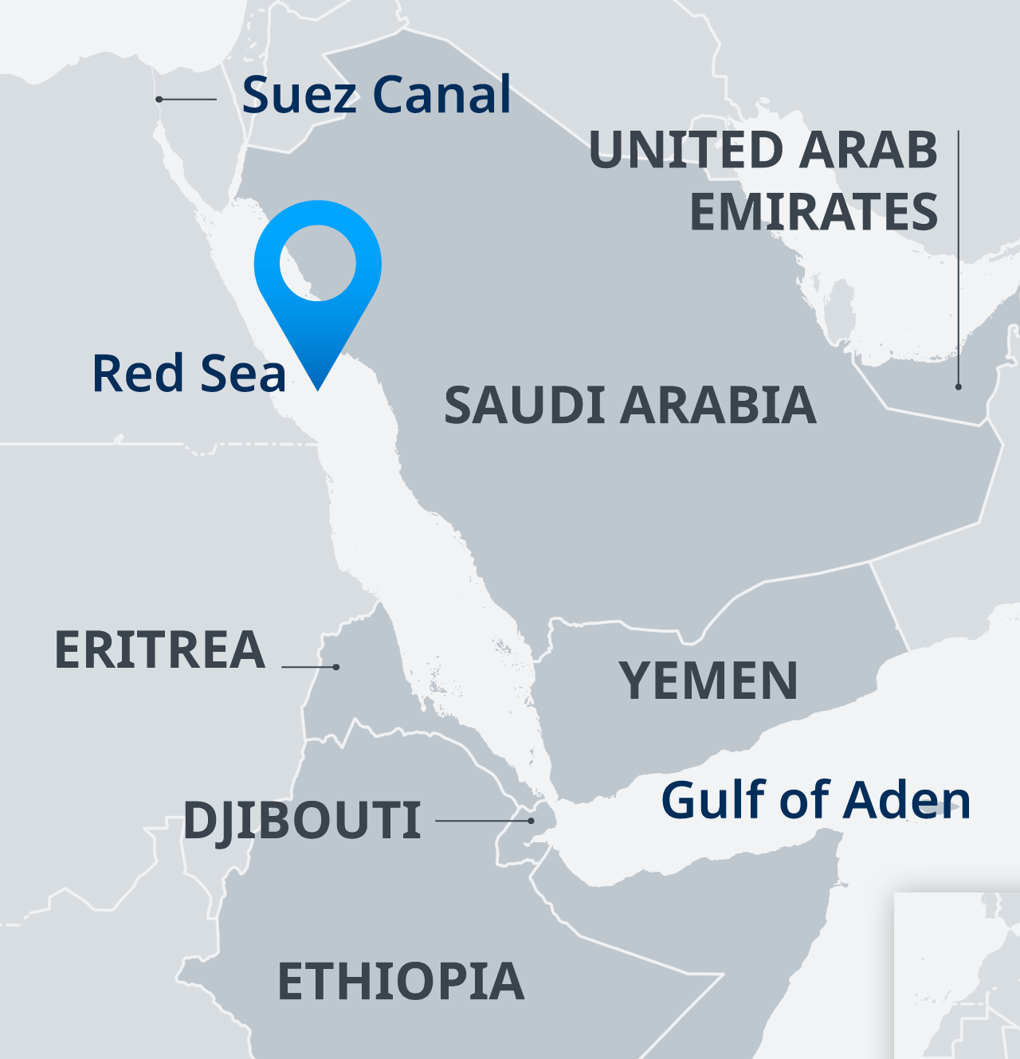
Area of ongoing danger for seafarers and ships
Gulf of Aden, Red Sea (between Yemen and Northeast Africa)
World trade through Suez disrupted by Houthi drone attacks, rockets and seizure since November 2023 leading to loss of life and property.
Dangerous high risk area for some time

Slide 3
Herculito Maritime Ltd v Gunvor Int BV (MV Polar) [2024] UKSC 2
United Kingdom Supreme Court judgment January 2024 as Houthi attacks were happening
Concerned consequences of seizure of the MV Polar by Somali pirates in the Gulf of Aden in 2010, same area, similar dangers but south of Gulf

Slide 4
Three points to start
0 1
Case reminder of risks to those who ensure world trade if we need one, how easily world trade can be disrupted by attacks in this area.

Slide 5
Three points to start (cont.)
0 2
Reminder for lawyers of contract regimes and specific issues under them:
Whether the insurance regime in a voyage charterparty prevented a claim for general average against cargo owners, and
Whether terms of charter were incorporated into bill of lading contracts.

Slide 6
Three points
0 3
Personal nostalgia because of a case note written ~40 years ago on an issue relevant to the insurance cord argument.

Slide 7
Facts
The MV Polar, on a voyage from St Petersburg to Singapore, was carrying a cargo of 70,000 m/t of fuel oil.
Seized by Somali pirates on 30 October 2010 and held for ten months
Eventually freed on 26 August 2011 after Owners paid ransom of US$7,700,000
Cargo largely intact but delivered late to 6 bill of lading holders

Slide 8
Facts
Owners declared general average for ransom payments – GA bond
Accepted that such payments were admissible in general average – extraordinary expense for preservation of ship or cargo
General average adjuster found that the cargo owners should pay US$5,914,560.17 as proportionate share in GA – challenged in arbitration and courts

Slide 9
Contractual arrangements
Owners
Voyage charter BPVOY4 including clause 39 War Risk, also Gulf of Aden and War Risk clauses
Charterer
Bills of lading (incorporation provision)
Bill of lading holders

Slide 10
Fixture (see [6])
Immediately below the applicable freight rates it was stated:
“All above via Suez with Suez costs to be for Owner’s account”.
Liberty for Owner under clause 39 of the charterparty had to be interpreted in light of this

Slide 11
Route (see [7])
The direct geographical route was via Suez and the Gulf of Aden. The Gulf was designated a “High Risk Area” for the purposes of marine insurance.

Slide 12
Insurance arrangements (see [9] – [10])
The shipowner took out Kidnap and Ransom insurance cover for up to US$5 million and increased their Hull & Machinery and War Risk insurance to cover the proposed transit through the Gulf of Aden.
Gulf of Aden clause provided for premium for additional insurance for kidnap and ransom up to US$40,000 for the charterer’s account. Also additional premia for War Risk up to USS40000 for charterer’s account

Slide 13
Main argument
Bill of lading holders argued they were not liable in general average for the ransom payment:
  On proper interpretation, the CP insurance regime under which the charterer paid premia for additional insurance, the shipowner could only recover ransom under insurance — they could not recover by claiming under CP.
  CP regime incorporated into B/L so no claim for general average against bill of lading holders

Slide 14
Related Arguments
Involved two related arguments:
  Proper construction of the charterparty, and
  Whether the insurance regime was incorporated to benefit the bill of lading holders.

Slide 15
Issue 1
Whether the charterparty contained contractual regime/code that prevented a claim in general average for ransom
On interpretation of the CP, did the parties agree to look to insurance, and not to sue for breach and/or claim general average?
The central issue in the Supreme Court

Slide 16
Issue 1 (cont.)
Commercial parties can enter into a contract containing an insurance regime and expressly agree to look to insurance and not sue each other.
  Common in construction projects
  Express provision — agreed by parties (and insurers involved).
  If no express agreement, depends on construction of the contract to find what the parties intended
  As a general principle, should be a rare result because it involves removing the basic right to sue under contract

Slide 17

Issue 1 – case law context
In the maritime context, this argument has been raised as a defence by a charterer to claim by owner for breach of safe port warranty in the charterparty
Rejected in most safe port cases

Slide 18
Issue 1 – charterparty cases
Only two decisions where obiter Court has found a contractual insurance regime in the charterparty that precluded claim for alleged breach of safe port warranty:
  Kodros Shipping Corp of Monrovia v Empresa Cubana de Fletes (The Evia (No 2)) [1983] 1 AC 736 (HL) (time charter – BALTIME)
  Gard Marine and Energy Ltd v China National Chartering Co Ltd (The Ocean Victory) [2017] UKSC 35 (demise charter – BARECON form)
In neither case was there in fact a breach of the safe port warranty

Slide 19
Issue 1 – The Evia
The Evia (No 2) is the only maritime case where an insurance code was found in the CP where there was no joint insurance
Heavily relied on in The Polar to say that there was a similar scheme under the CP

Slide 20
Issue 1 – landlord and tenant cases
Bill of lading holders also referred to landlord and tenant cases where fire insurance provisions meant that there could be no claim between landlord and tenant – parties agreed to look to insurance fund
  Leading case is Mark Rowlands Ltd v Berni Inns Ltd [1986] QB 211
  See case note by young lawyer in 1986 in LMLQ saying that these cases could not be applied to support argument from The Evia in c/p cases

Slide 21
Judgment of Supreme Court (Lord Hamblen)
Noted generally high threshold to interpret provisions to remove a common law right (i.e. general average) or right to sue.
Regime in The Evia (No 2) on materially different terms
  See judgment at [57] – [73]: important the Owner did not have broad general liberty — because of by Suez agreement — insurance was for this agreed route
  No exceptional result if charterer paid insurance to have this route

Slide 22
Judgment of Supreme Court (Lord Hamblen) (cont.)
SC concluded that The Evia (No 2) provided no basis to support the insurance fund or code argument under this charterparty

Slide 23
Judgment of Supreme Court (Lord Hamblen) (cont.)
General observations:
  Leaving cases of joint insurance to one side, the search for an insurance code was productive of uncertainty
  Advised caution in trying to apply The Evia (No 2) to other charters – decision on those particular terms
Basic position:
  Absent express provision, insurance provisions should not prevent claims that would usually be available

Slide 24
Issue 1 – Result
Held that there was no insurance regime in charterparty preventing general average claim by owners that might be incorporated into bills:
  “…The cargo interests’ case therefore falls at the first hurdle. There was no insurance code which could be incorporated into the bill of lading contracts.” (at [75])

Slide 25
Issue 2 - incorporation
Incorporation of charterparty terms into bills of lading
Issue often seen in New Zealand import and export shipments — what are terms of BL contract?
Issues on incorporation argument considered by Supreme Court: helpful in setting out general approach and summarising principles

Slide 26
Consideration of incorporation issue
Incorporation clause in bill of lading :
  “Pursuant to all terms conditions liberties and exceptions as per Tanker Voyage CP ( and overleaf)”

Slide 27
Consideration of incorporation issue (cont.)
Observations on incorporation by Lord Hamblen:
  General words incorporate provisions relating to (germane to) shipment carriage and discharge of cargo
Insurance provisions setting out basis for transiting Gulf of Aden, insurance premia payment were germane to carriage so incorporated

Slide 28
Consideration of incorporation issue (cont.)
BUT when read into Bill of lading referred to obligations on the charterer to pay insurance not bill of lading holders
AND no basis to manipulate to make provisions apply to bill of lading holder
Made sense as provisions referring to charterers obligation to pay premia for transit Gulf and Suez
No incorporation of scheme applicable to bill of lading holders even if there was one under the CP

Slide 29
Concluding comments
Important consideration of contract regime argument limiting The Evia
Asserts basic position that absent express provision in a contract should not remove common law rights
  Insurance obligations should not affect this

Slide 30
Concluding comments (cont.)
Very clear exposition of general principles relating to incorporation
Excellent clear judgment well worth all studying
Overall strong reminder of dangers and risks facing seafarers and ships

Slide 31
Questions?

Slide 32
Thank you
Paul David KC | Eldon Chambers | paul@pauldavid.co.nz

